Slide 1
Plan for rest of the semester
This week Lab 8: last lab
Due week after (week of Nov 10th )
Weeks of Nov 17th and Dec 1st: Final project
Run your own experiments using any equipment from the semester + more options
More information on Canvas
Individual assignment in the form of a digital poster
Due Dec 8th
Weeks of Nov 17th and Dec 1st :
If you need to make up labs, you can use this week for those
Lab resubmissions: Due Dec 8th (same as Final Project)
Resubmit one of your assignments to receive ½ of the missed points back
If you need to collect more data, can do so during the makeup week

Slide 2
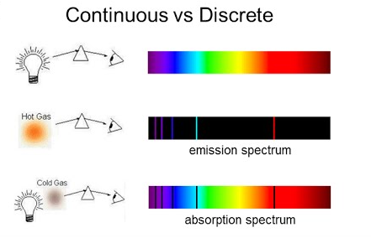
Continuous vs discrete
Hot solid emits continuous spectra (black body radiation)
Hot gas emits discrete emission spectra (quantum mechanics)
Cold gas with external light source will have absorption spectra

Slide 3
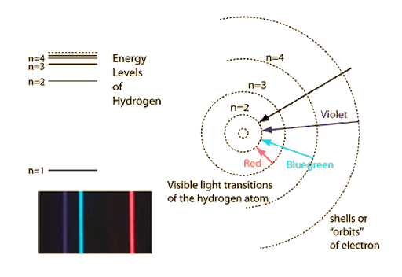

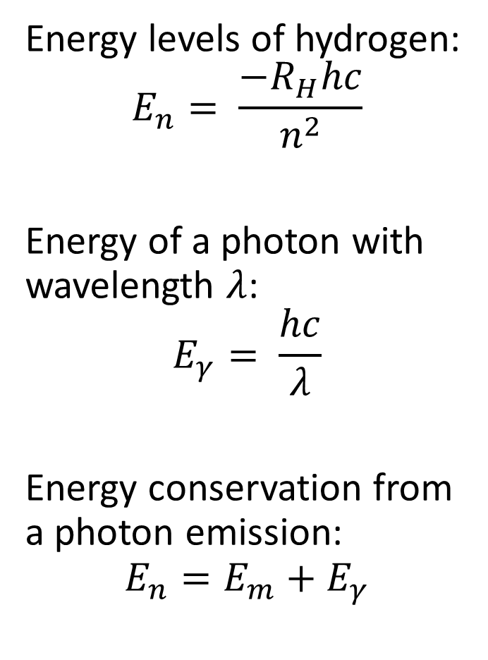
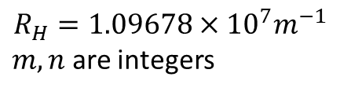
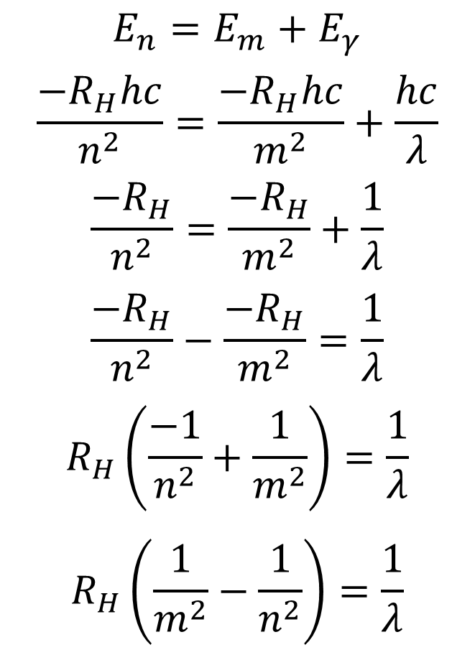
Derivation of equation
Derivation
Energy levels of hydrogen:
$$E_{n}= \frac{−R_{H}hc}{n^{2}}$$
Energy of a photon with wavelength $λ$:
$$E_{γ}= \frac{hc}{λ}$$
Energy conservation from a photon emission:
$$E_{n}=E_{m}+E_{γ}$$
$$E_{n}=E_{m}+E_{γ}$$
$$\frac{−R_{H}hc}{n^{2}}=\frac{−R_{H}hc}{m^{2}}+\frac{hc}{λ}$$
$$\frac{−R_{H}}{n^{2}}=\frac{−R_{H}}{m^{2}}+\frac{1}{λ}$$
$$\frac{−R_{H}}{n^{2}}−\frac{−R_{H}}{m^{2}}=\frac{1}{λ}$$
$$R_{H}\left(\frac{−1}{n^{2}}+\frac{1}{m^{2}}\right)=\frac{1}{λ}$$
$$R_{H}\left(\frac{1}{m^{2}}−\frac{1}{n^{2}}\right)=\frac{1}{λ}$$
$$\frac{1}{λ}=R_{H}\left(\frac{1}{m^{2}}−\frac{1}{n^{2}}\right)$$
$$R_{H}=1.09678×{10}^{7}m^{−1}$$
$m,n$ are integers

Slide 4
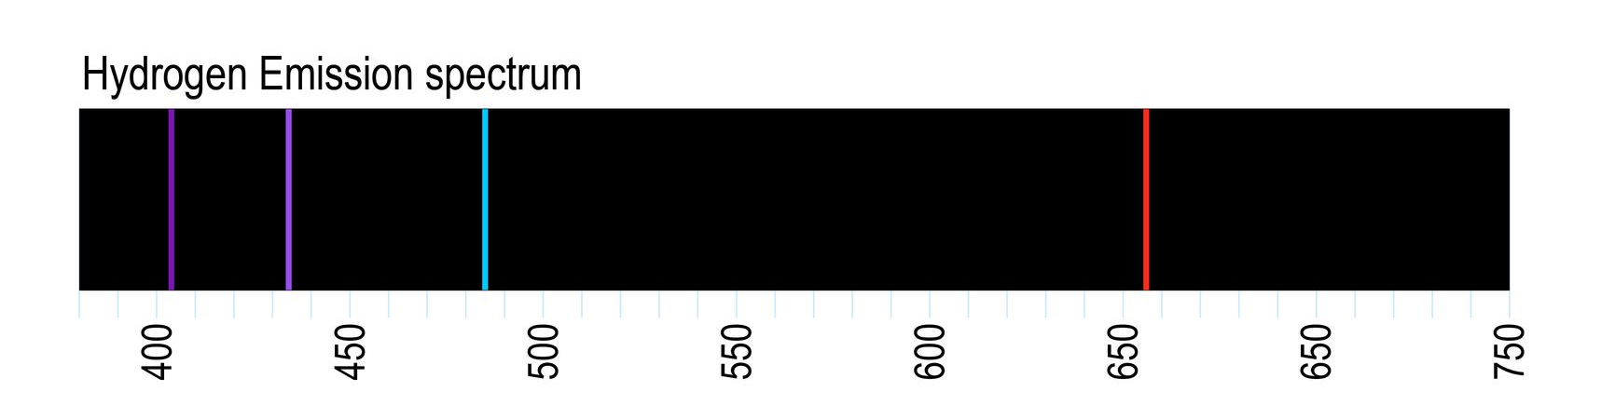

Hydrogen emission spectrum
Using $\frac{1}{λ}=R_{H}\left(\frac{1}{m^{2}}−\frac{1}{n^{2}}\right)$, calculate possible $λ$ by plugging in different values of n, m
$λ$ given in nm for Table
Visible spectrum (400-750nm) emission lines:
410.29nm
434.17nm
486.27nm
656.47nm
https://physics.nist.gov/PhysRefData/Handbook/Tables/hydrogentable2.htm

Slide 5
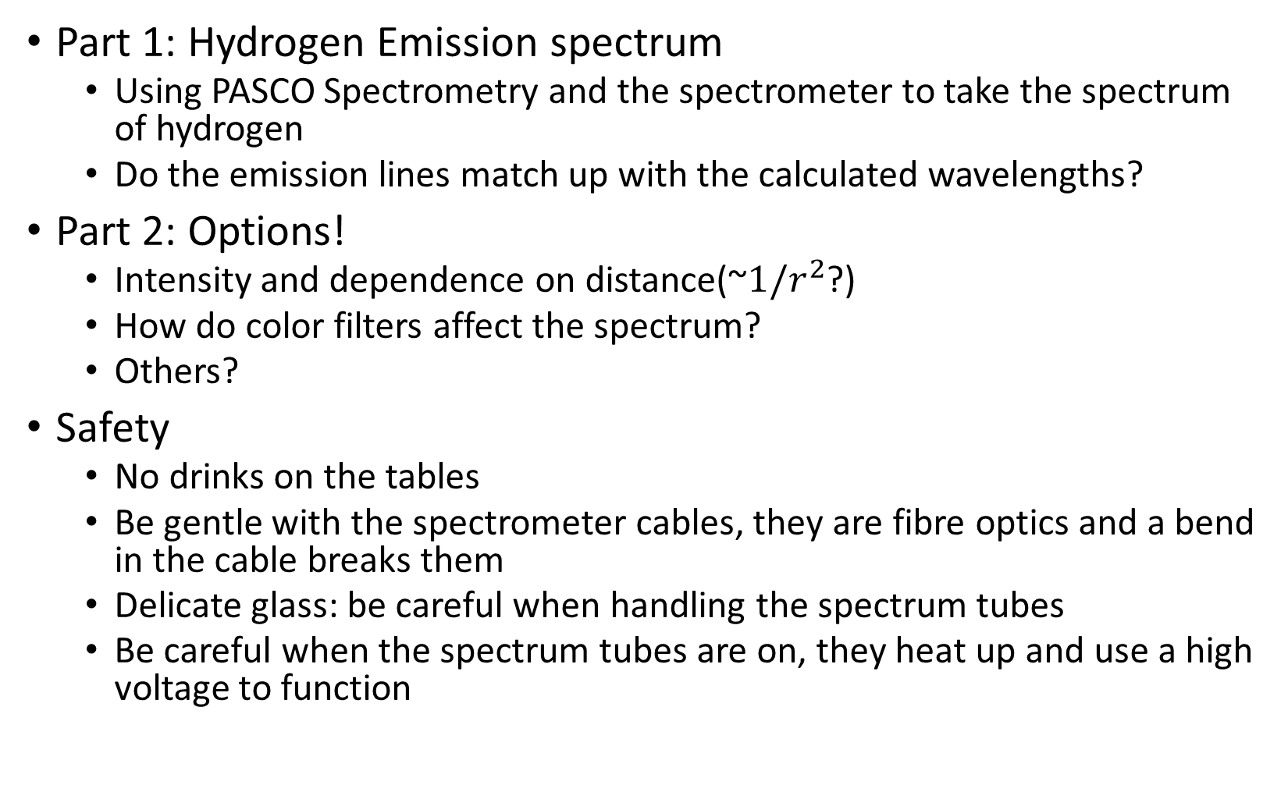
Lab 8
Part 1: Hydrogen Emission spectrum
Using PASCO Spectrometry and the spectrometer to take the spectrum of hydrogen
Do the emission lines match up with the calculated wavelengths?
Part 2: Options!
Intensity and dependence on distance(~$1/r^{2}$?)
How do color filters affect the spectrum?
Others?
Safety
No drinks on the tables
Be gentle with the spectrometer cables, they are fibre optics and a bend in the cable breaks them
Delicate glass: be careful when handling the spectrum tubes
Be careful when the spectrum tubes are on, they heat up and use a high voltage to function

